Slide 1
Connecting Microburst Precipitation to Its Scattering Mechanism
Mykhaylo (Mike) Shumko
October 16th, 2019
Dissertation Defense

Slide 2
Outline
Introduction
Magnetosphere
Radiation belt particles and waves
Microburst precipitation
Estimate the microburst size distribution and compare it to the waves believed to generate microbursts
Case study with FIREBIRD-II
Statistical study with AeroCube-6
Model microbursts observed in the heart of the outer radiation belt
Paths forward

Slide 3
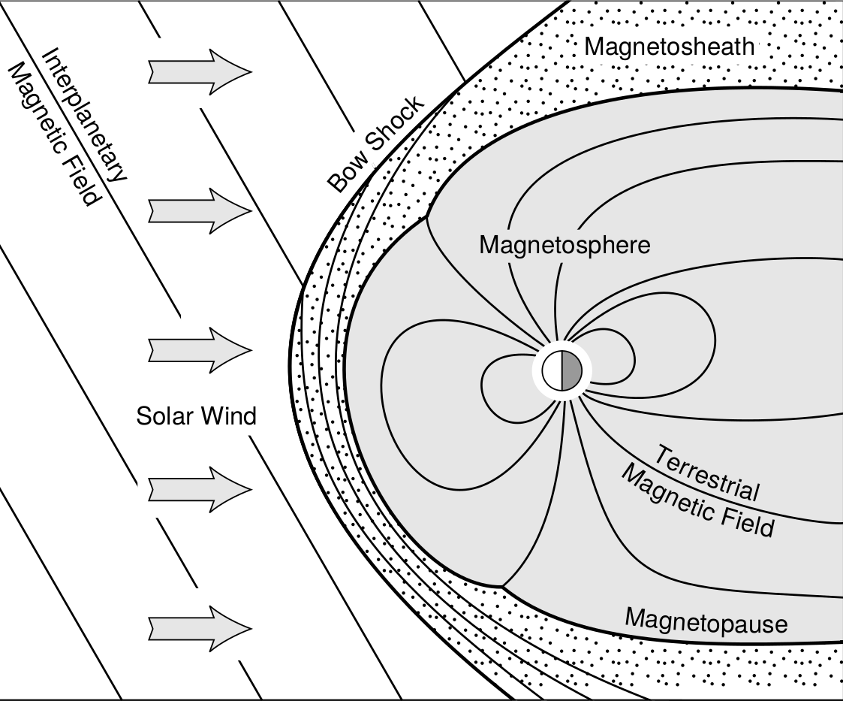
The magnetosphere
Baumjohann and Treumann 1997

Slide 4
The magnetosphere
Baumjohann and Treumann 1997

Slide 5
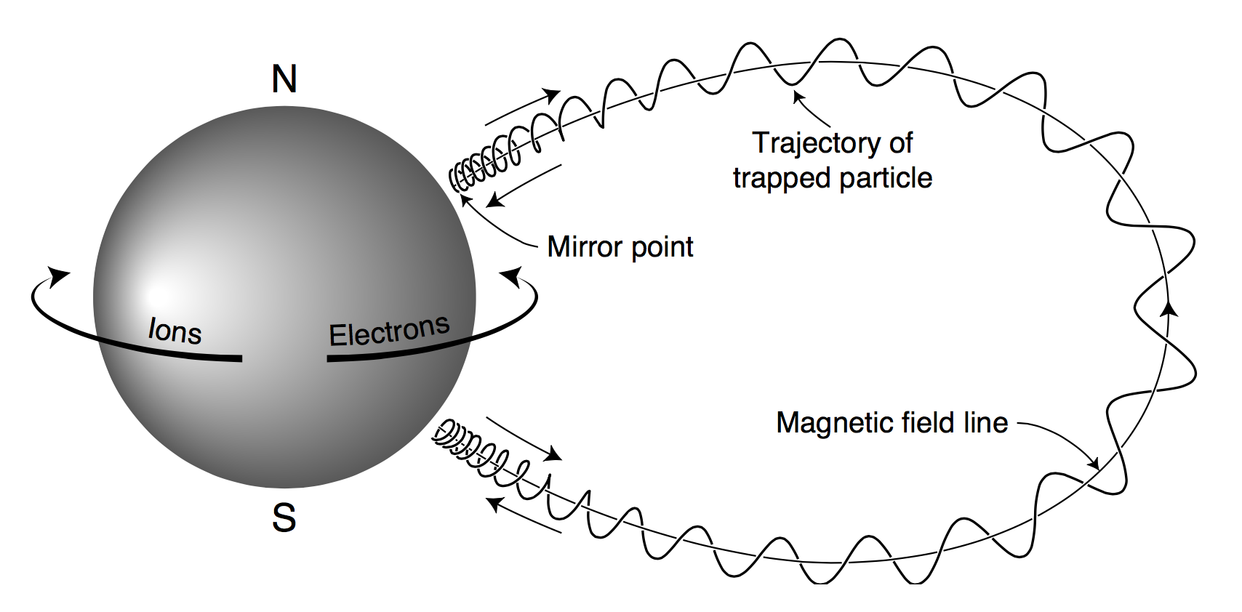
Charged particle motion in Earth’s magnetic field
Dipole magnetic field is the dominant component.
Charged particles exhibit three type of motion from the Lorentz force that have corresponding adiabatic invariants
Gyro motion ~ 1 kHz
Bounce motion ~ 1 Hz
Drift motion ~ 1 mHz
Violation of these invariants lead to many non-linear phenomena.
Baumjohann and Treumann 1997

Slide 6
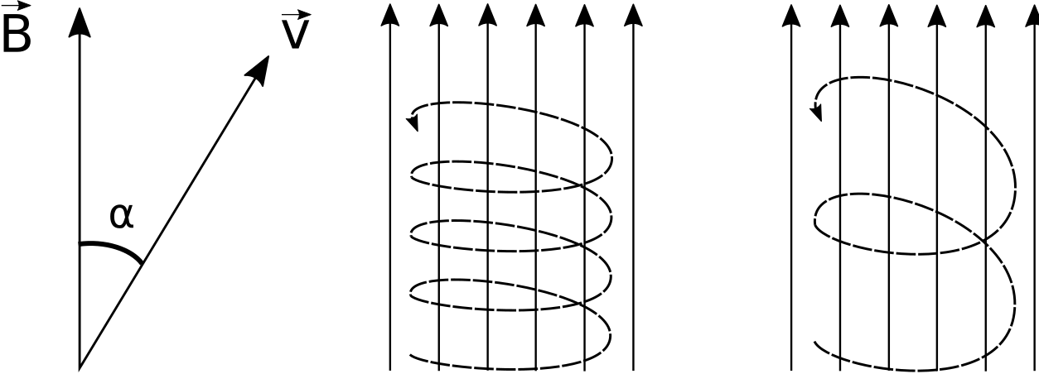
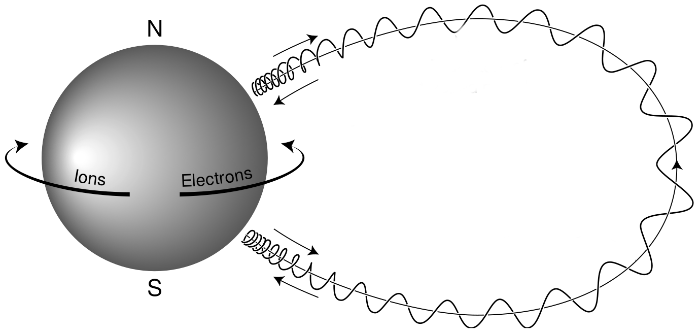
Particle's Pitch Angle, α
large α
small α
Angle between the local magnetic field and the velocity vectors
A particle with a large α will mirror closer to the magnetic equator relative to a smaller α
Baumjohann and Treumann 1997

Slide 7
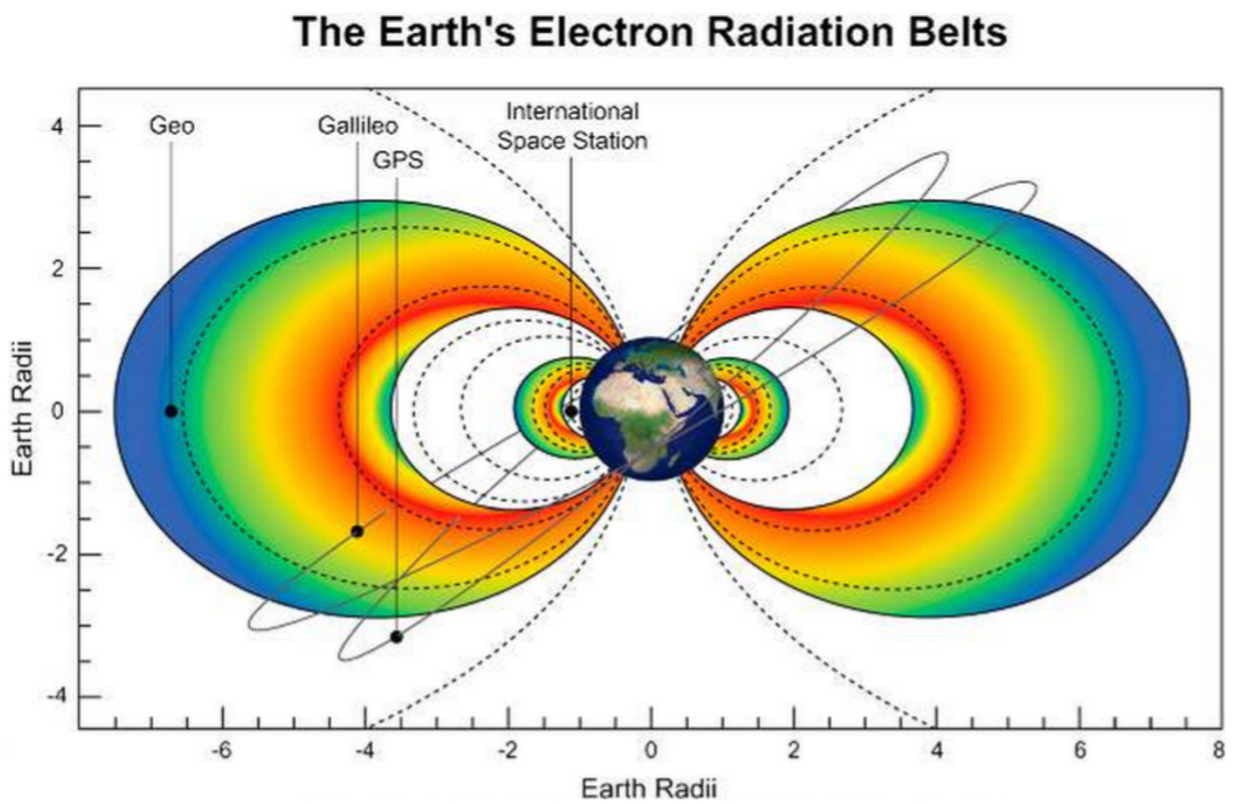
Van Allen Radiation Belts
Inner belt
Energy: MeV to GeV H⁺
up to 1 MeV e⁻
Composition: mostly H⁺
Source:
H⁺ -cosmic ray albedo neutron decay
e⁻ -inward radial transport
Extent: L < 2
Outer belt
Energy: 100 – 1000s keV e⁻
Composition: mostly e⁻
Source: particle injections followed by wave acceleration
Extent: 4 < L < 8
Horne et al., 2013

Slide 8
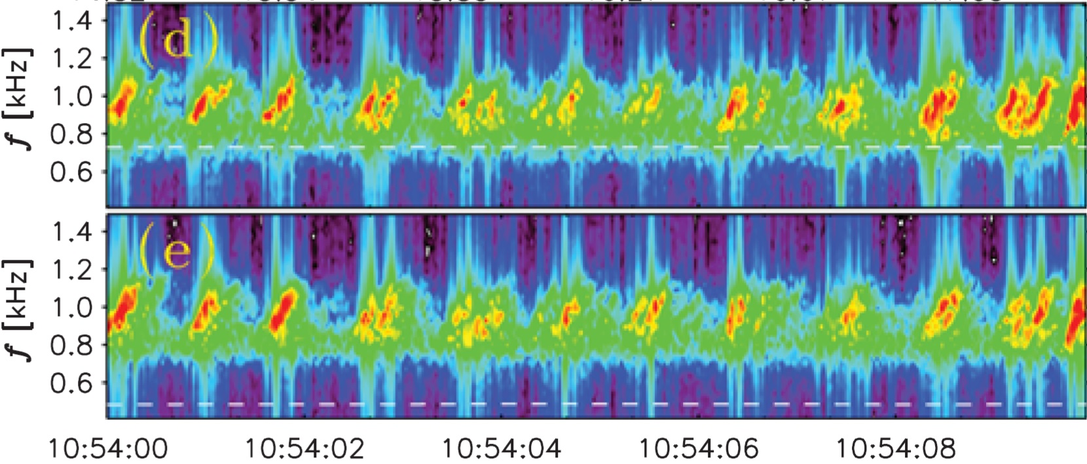

Whistler-mode Chorus Waves
Figure from Agapitov et al. 2017
Audio from the EMFISIS team (NASA/University of Iowa)

Slide 9
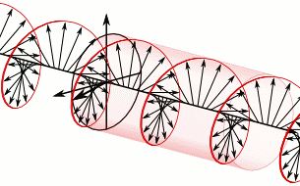
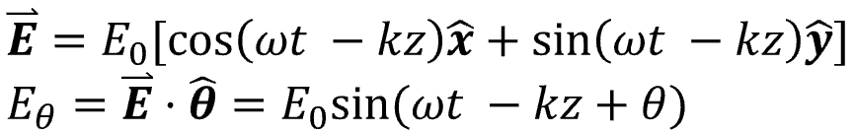
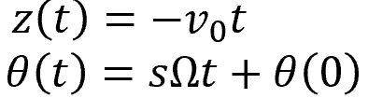

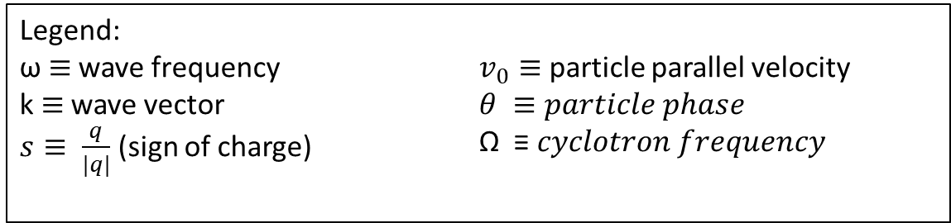
Toy model of wave-particle scattering with field-aligned chorus
Assume a circularly polarized wave traveling along the background magnetic field in the z direction.
x
Also assume the electron is gyrating in the x-y plane with a velocity in the –z direction.
y
z
Legend:
ω $≡$ wave frequency
k $≡$ wave vector
$s≡ \frac{q}{|q|}$ (sign of charge)
$v_{0}≡$ particle parallel velocity
$θ ≡particle phase$
Ω ≡ 𝑐𝑦𝑐𝑙𝑜𝑡𝑟𝑜𝑛 𝑓𝑟𝑒𝑞𝑢𝑒𝑛𝑐𝑦

Slide 10
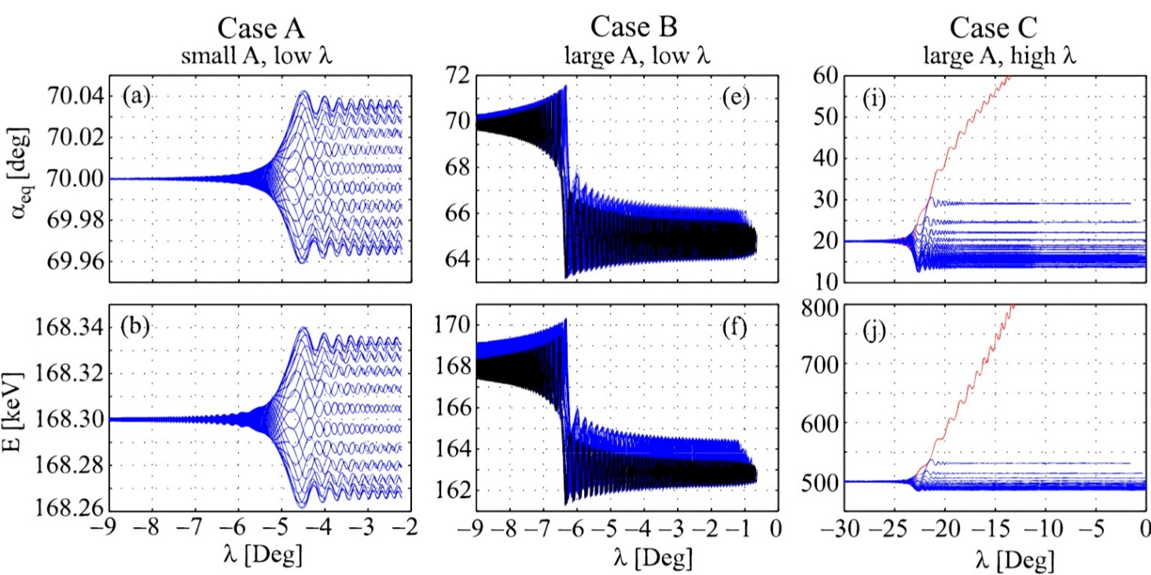
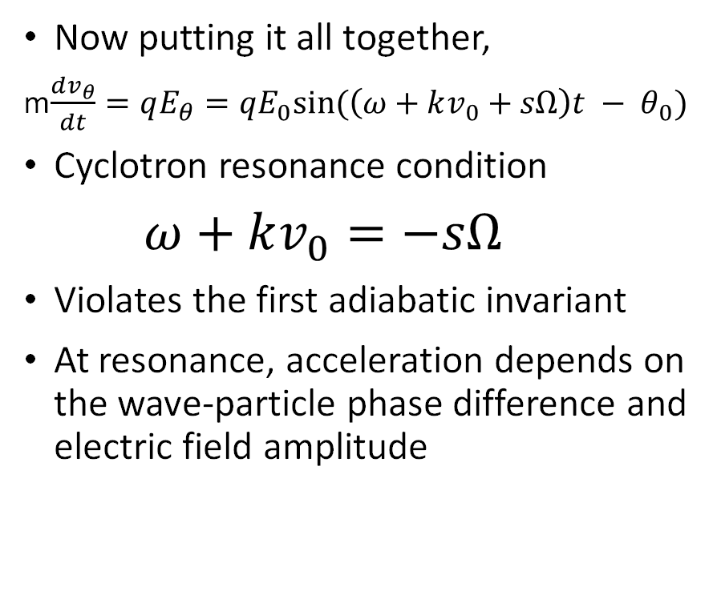
Toy model of wave-particle scattering (cont)
Now putting it all together,
m$\frac{dv_{θ}}{dt}=qE_{θ}=qE_{0}sin⁡(\left(ω+kv_{0}+sΩ\right)t − θ_{0})$
Cyclotron resonance condition
$ω+kv_{0}=−sΩ$
Violates the first adiabatic invariant
At resonance, acceleration depends on the wave-particle phase difference and electric field amplitude
Bortnik et al. 2008

Slide 11
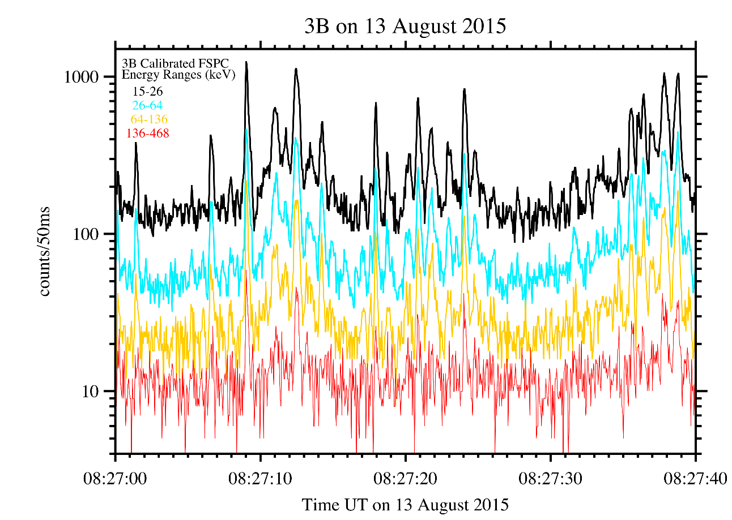
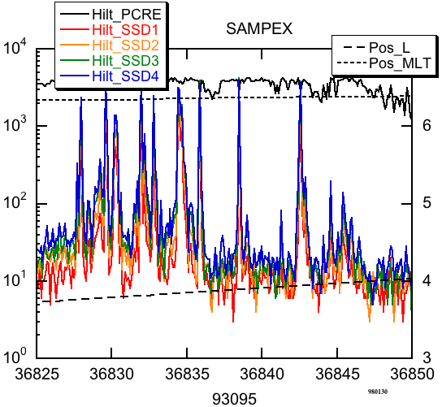
Electron Microbursts
One manifestation of wave-particle interactions are microbursts
Microbursts are a < 1 second intense bursts of electrons
First reported by Anderson and Milton 1964
Observed with a high altitude balloon
Observed by LEO spacecraft
Studies show that microbursts can
deplete the outer radiation belt electrons on the order of hours to days
influence atmospheric chemistry
Anderson et al., 2015
Blake et al., 1996

Slide 12
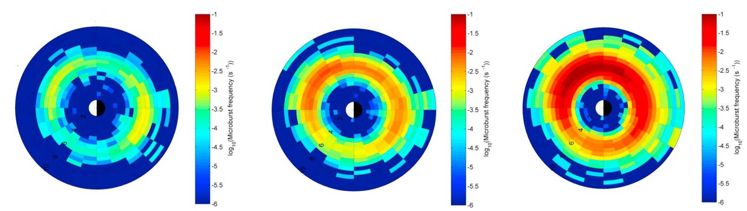
Electron Microbursts (cont)
Douma et al., 2017
Microbursts are observed under the outer radiation belt footprints (4 < L < 8)
In the 0-12 magnetic local time
Occur more frequently when the magnetosphere is disturbed

Slide 13
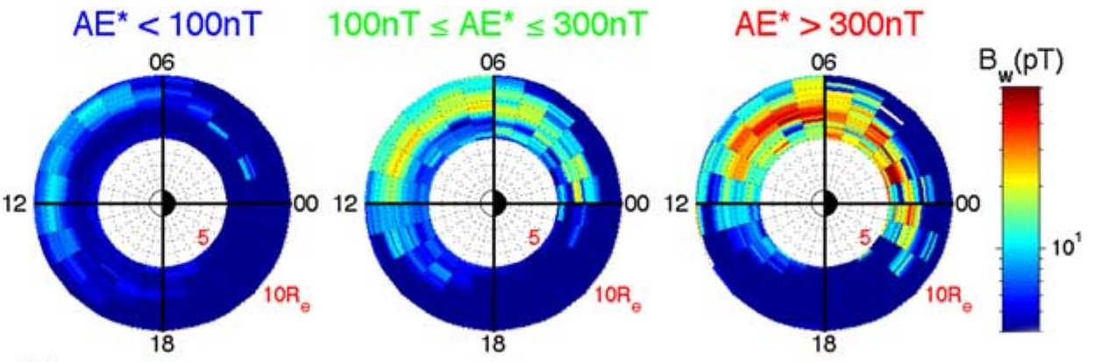
Correlation between Microburst and Chorus
Chorus waves occur in a similar MLT region as microbursts
This spatial similarity hints that chorus waves scatter microbursts
Not much is known about the microburst scattering mechanism
Li et al., 2009

Slide 14
The Microburst Scattering Mechanism
Why study the microburst scattering mechanism?
More accurately predict when microbursts occur and thus better predict their effects on the environment and human presence in space
Fill in missing physics of how waves and particles interact in the plasma
Determine if microburst scattering mechanism is a diffusive or non-linear process
Roadblocks
Very sparse data coverage
Microbursts and waves are never observed in the same place
Magnetic conjunction studies, e.g. Breneman et al., 2017, try to link the waves and microburst electrons but good conjunctions are rare
Our approach
Estimate the microburst size distribution and compare it to the wave distribution
Study the microburst scattering in-situ in the heart of the outer radiation belt
Notes:
Describe what a conjunction is

Slide 15
Estimating the size of a bouncing packet microburst with FIREBIRD-II
Shumko, M., Sample, J., Johnson, A., Blake, B., Crew, A., Spence, H., ... & Handley, M. (2018). Microburst Scale Size Derived From Multiple Bounces of a Microburst Simultaneously Observed With the FIREBIRD‐II CubeSats. Geophysical Research Letters, 45(17), 8811-8818.

Slide 16
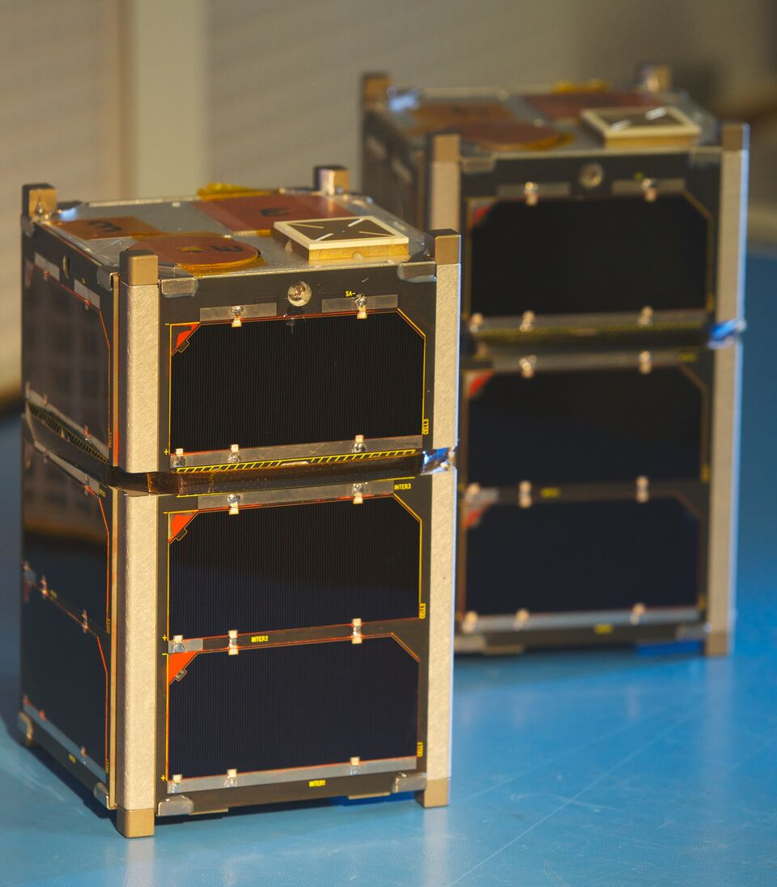
The FIREBIRD-II Mission
Build by MSU and University of New Hampshire
Pair of CubeSats launched on January 2015 into 600x400 km, 99° inclination orbit
Separation in-track
Six programmable energy channels observing electrons from 200 keV to > 1 MeV
Still operational and commanded by Arlo Johnson and me
Show prop here
Notes:
FIREBIRD == Focused Investigations of Relativistic Electron Bursts: Intensity, Range, and Dynamics

Slide 17
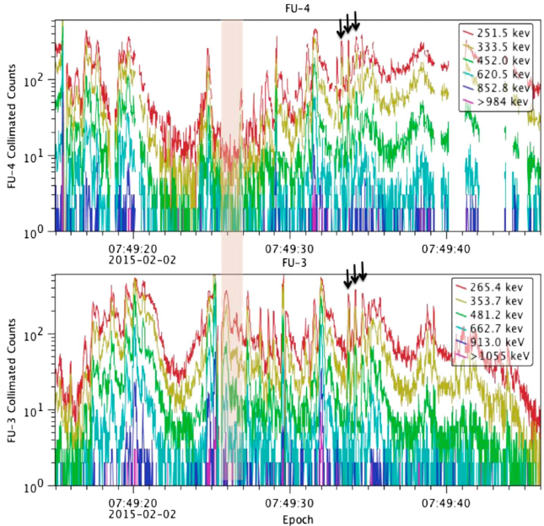
Determine The Size of Microbursts
One of FIREBIRD-II's science goals was to estimate the size of individual microbursts
Crew et al., 2016 first reported microbursts observed simultaneously by FIREBIRD-II
The size of those microbursts was greater than >11 km
Soon after, we found a larger microburst
Crew et al., 2016

Slide 18
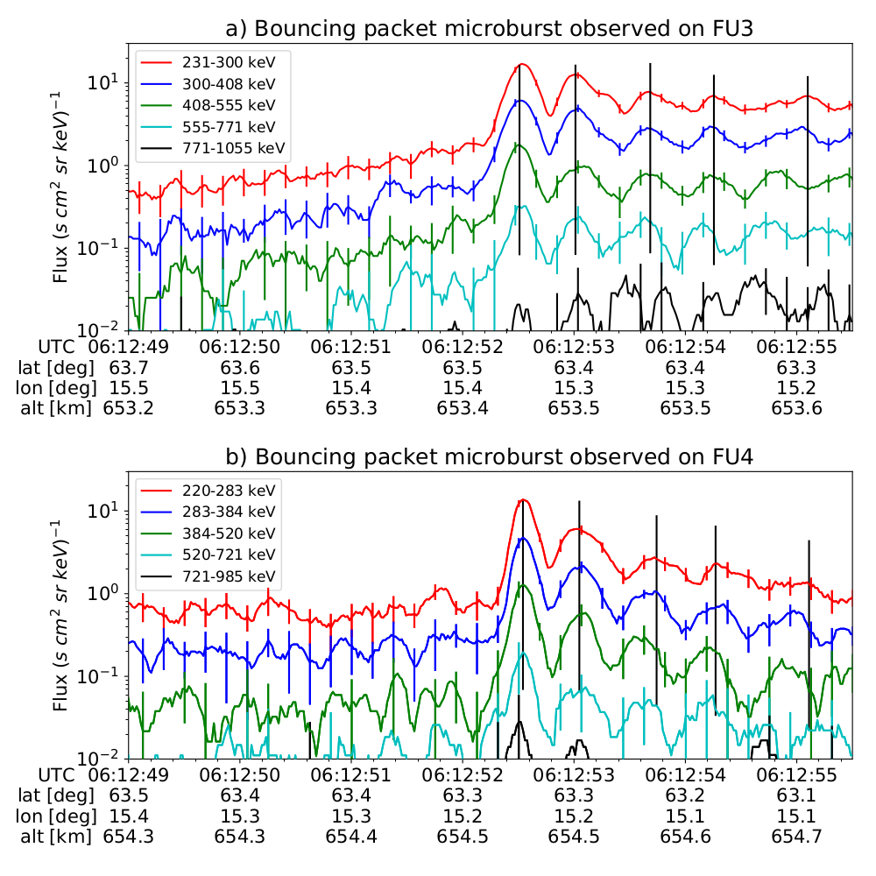
Microburst Observation
Microburst and subsequent bounces seen by both FIREBIRD-II units on February 2nd, 2015 above Sweden
Microburst electrons with energies up to 555-771 keV were scattered
FU3 and FU4 were separated by ≈ 20 km

Slide 19
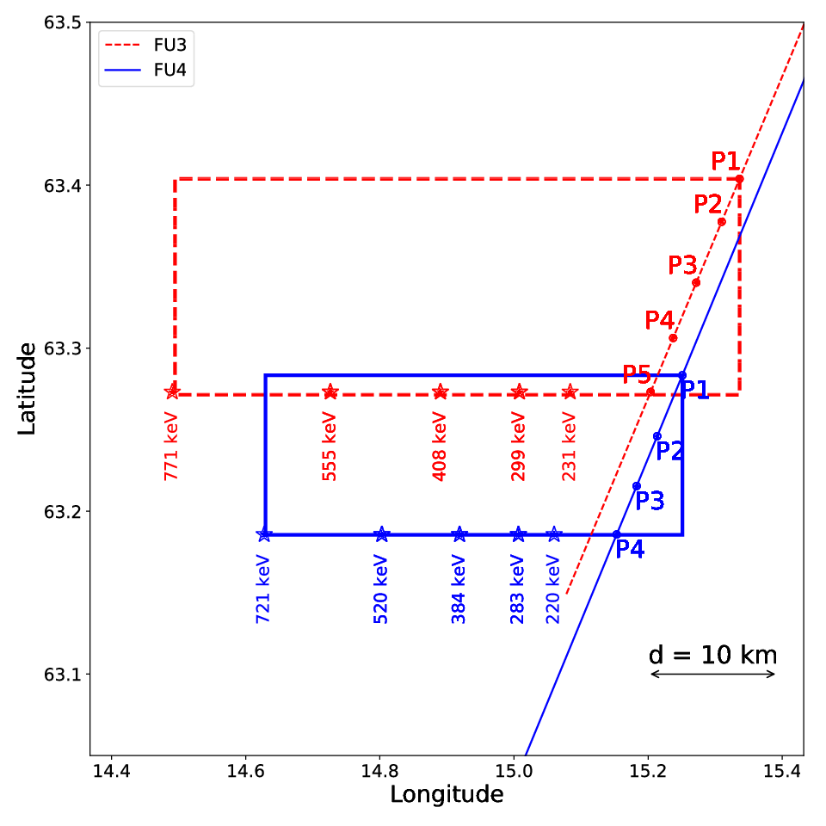
Microburst Size Estimated From Orbit Geometry
Microburst size in LEO
Latitudinal: > 29 ± 1 km
Longitudinal: > 51 ± 1 km
Microburst size at the magnetic equator
Radial: > 500 ± 10 km
Azimuthal: > 530 ± 10 km
Equatorial microburst size is similar to the whistler-mode chorus source scale sizes reported in [Agapitov et al., 2011, 2017]

Slide 20
Microburst Size Distribution Derived with AeroCube-6
M. Shumko, A.T. Johnson, J.G. Sample, B.A. Griffith, D.L. Turner, T.P. O’Brien, O. Agapitov, J.B. Blake, and S. G. Claudepierre (2019). Microburst Size Distribution Derived with AeroCube-6. Submitted to Journal of Geophysical Research

Slide 21
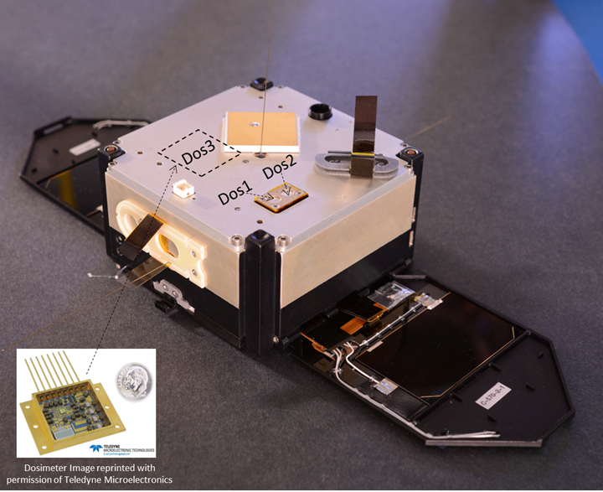
The AeroCube 6 (AC-6) mission
Pair of CubeSats, launched in June 2014 into a 620x700km, 98 degree inclination orbit
Built by The Aerospace Corporation
Their separation is mostly in-track, and is controlled via differential drag
Dosimeters measure
> 35 keV, and > 1 MeV electrons
> 400 keV, and >20 MeV protons
O’Brien et al. [TOR-2016-01155]
Notes:
AC6 has controllable separation, and FIREBIRD did not.

Slide 22
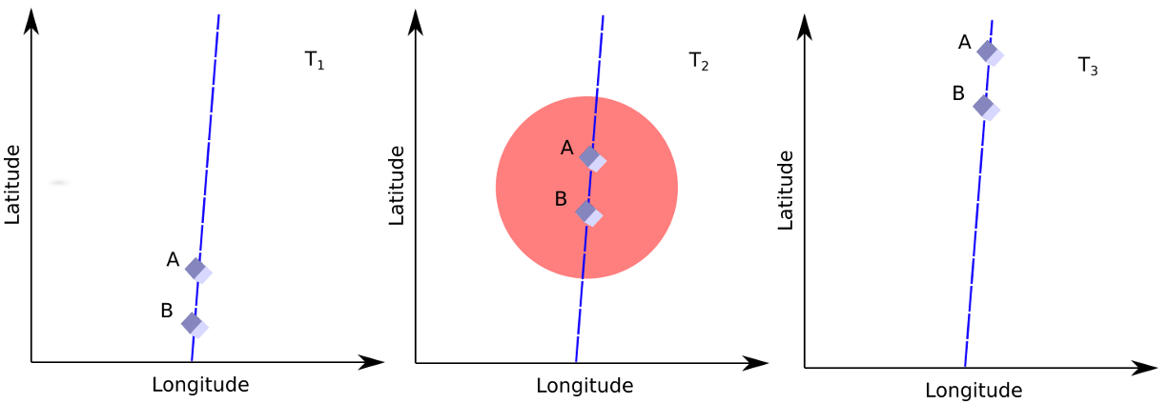
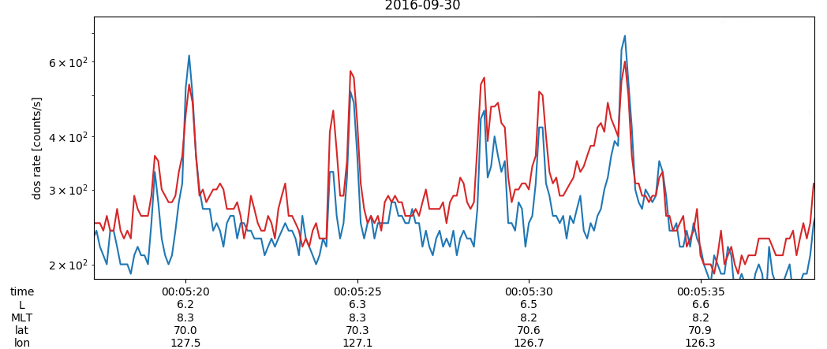
Idea Of The Study
Expand the FIREBIRD-II and other case studies with a statistical study using AC-6
AC-6 has observed numerous coincident microbursts at varying separations
These detections can then be used to find the distribution of microburst sizes in low Earth orbit and the magnetic equator
The distributions of microbursts and waves can then be directly compared.

Slide 23
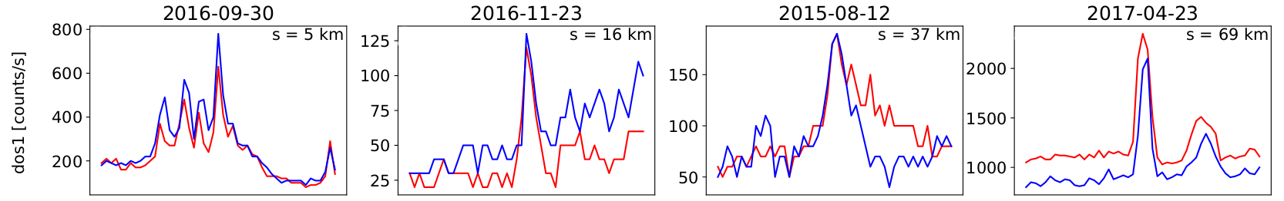
Microburst detection and event selection
Microbursts identified with the burst parameter [O'Brien et al., 2003]
To find microbursts observed simultaneously by AC-6:
microburst data were correlated between the two spacecraft
microbursts with correlation > 0.8 were considered coincident

Slide 24
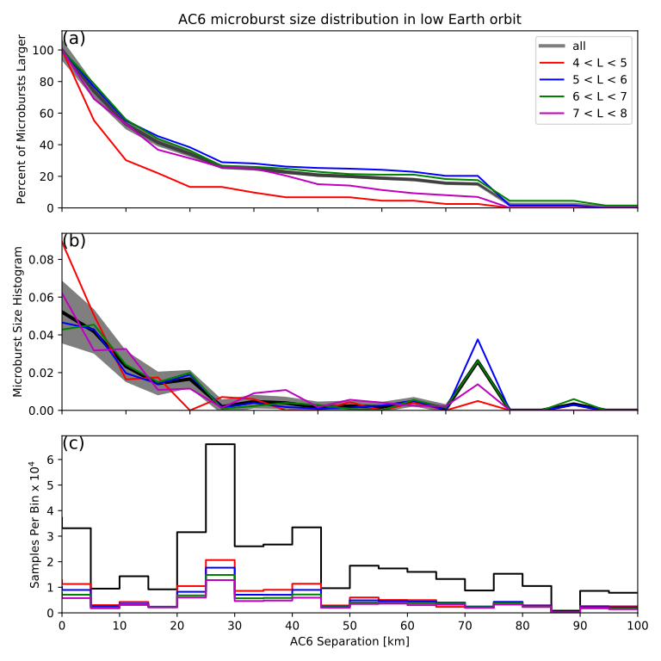
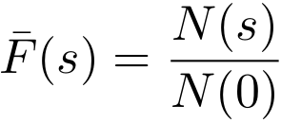
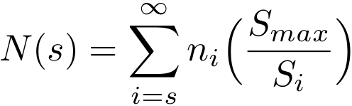
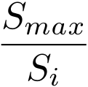
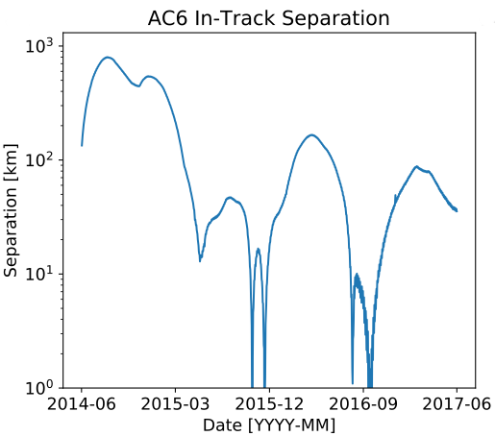
Microburst size distribution in low Earth orbit
Well-correlated microburst detections were used for the microburst size distribution
The cumulative fraction of microbursts observed above AC-6 separation, s is
The term is the normalization for the AC-6 separation
Right plot panels:
Top – microburst F(s)
Middle – microburst probability density
Bottom – Number of AC-6 samples in separation bin

Slide 25
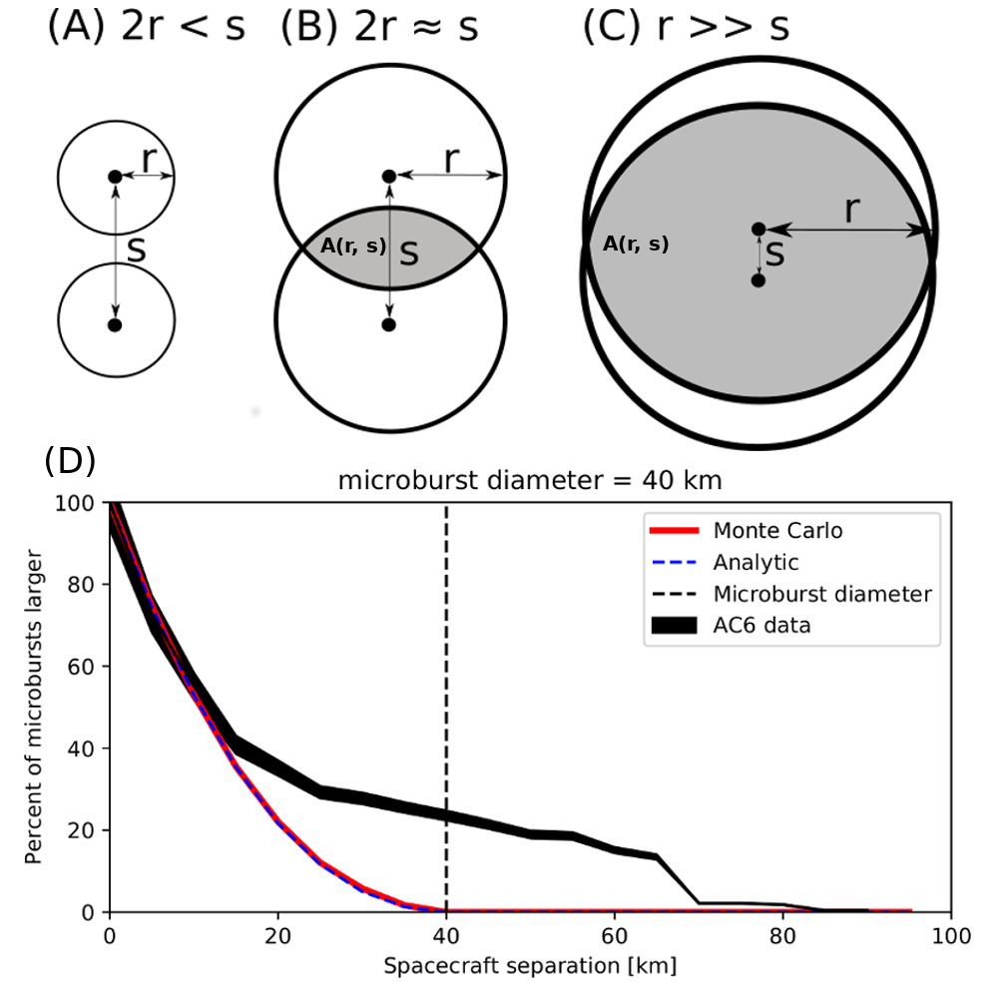
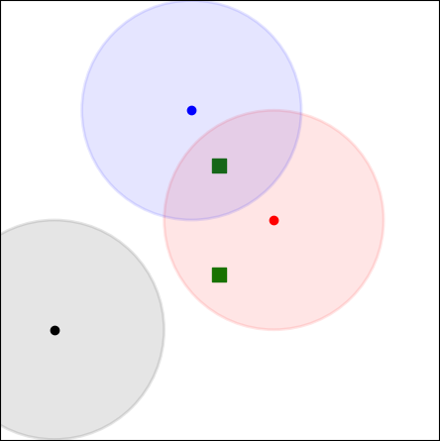
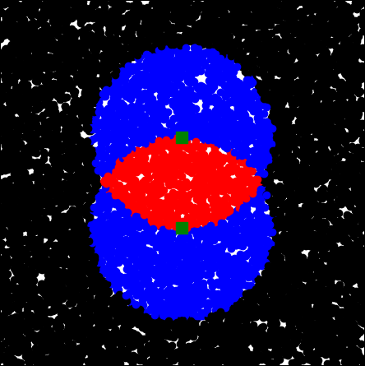
Modeling the Microburst Distribution
We have to do more work to make the microburst distribution more intuitive
The compounding effects due to random microburst locations and sizes were modeled
Monte Carlo model is more flexible
Analytic model highlights geometry
Assumptions:
Microburst occur randomly around AC6
Microburst footprint is circular
Prescribed microburst probability density function (PDF)

Slide 26
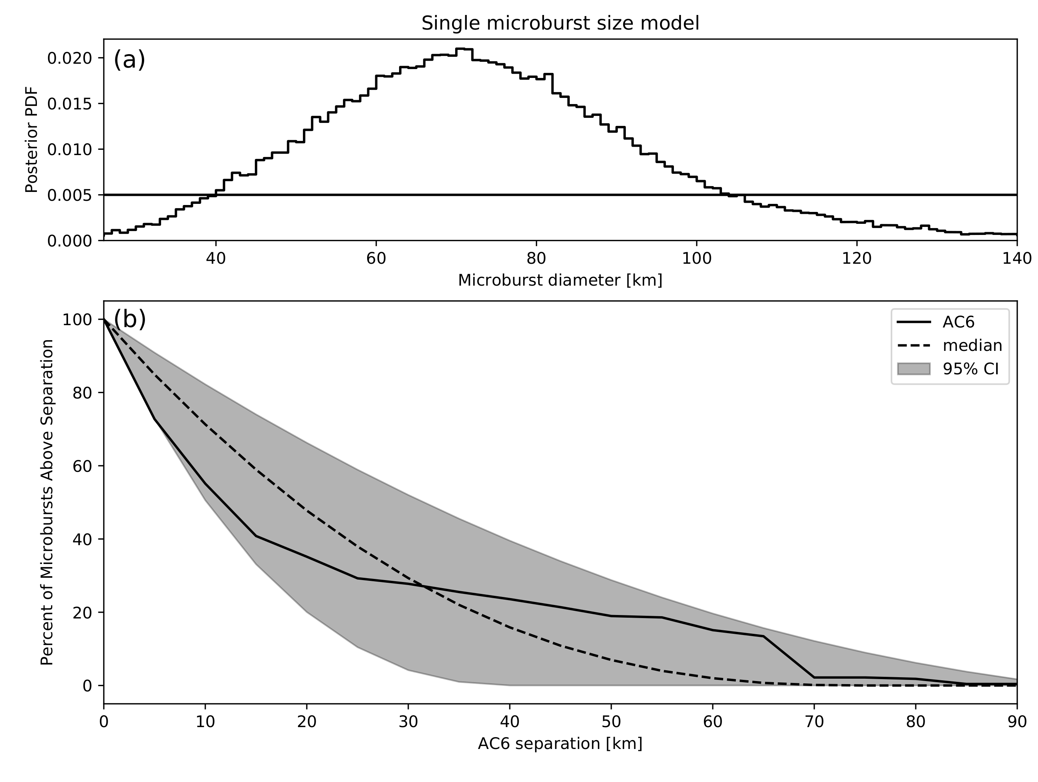
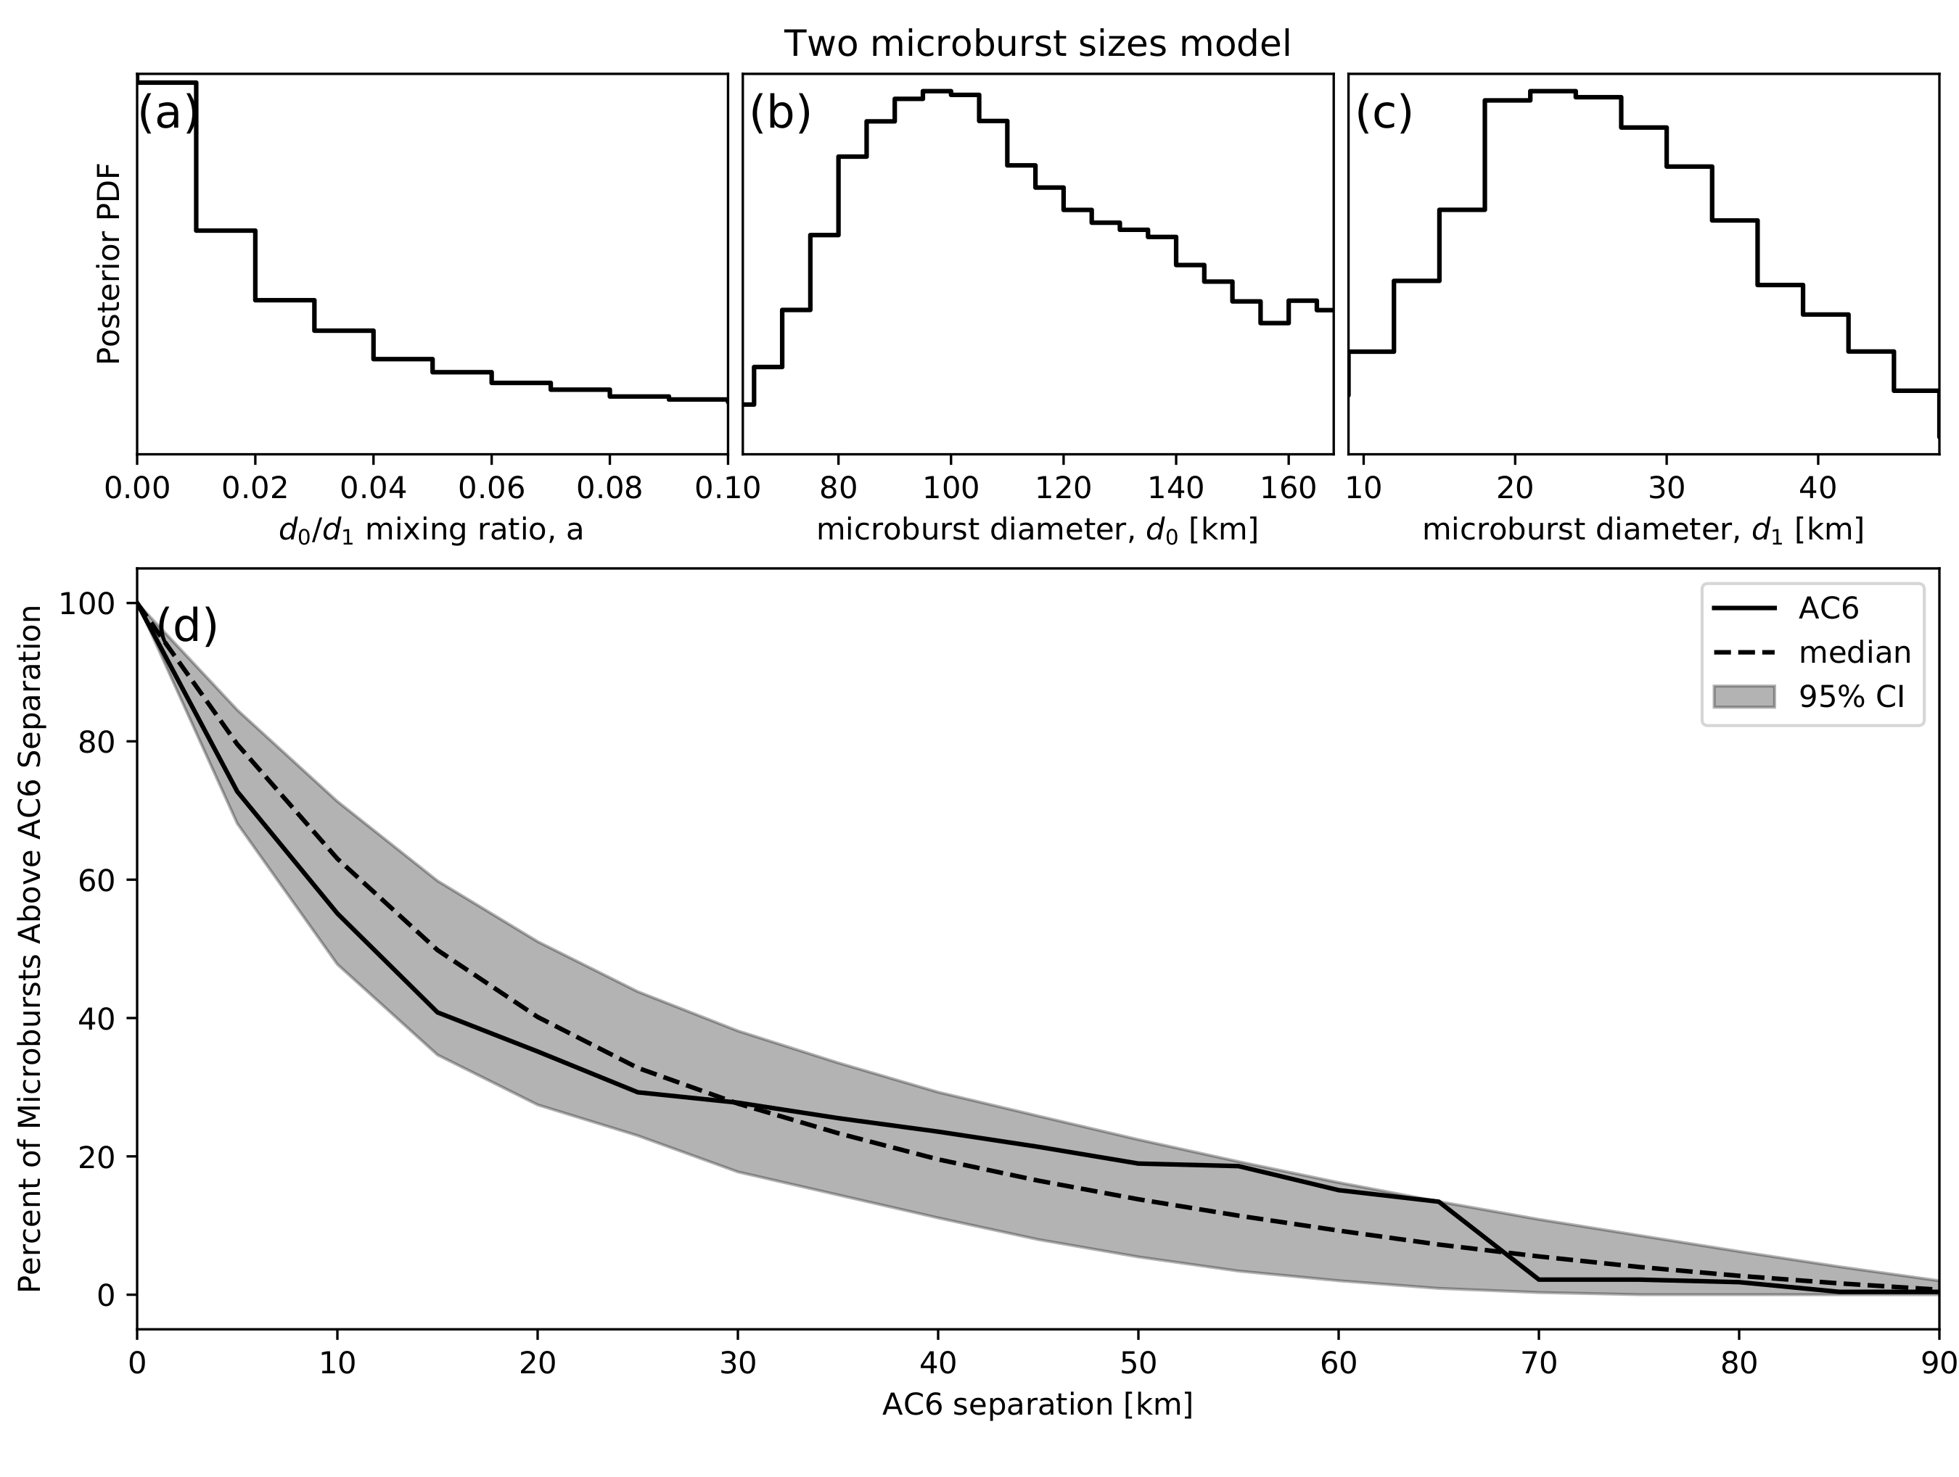
Modeling various hypothesized microburst size distributions
f(d|d₀) = δ(d-d₀)
Consistant range of d₀: 38-129 km | median 73 km
f(d|a, d₀, d₁)= aδ(d-d₀) + (1-a)δ(d-d₁)
0.1% < a < 16% | 12 < d₀ < 47 km | 76 < d₁ < 234 km

Slide 27
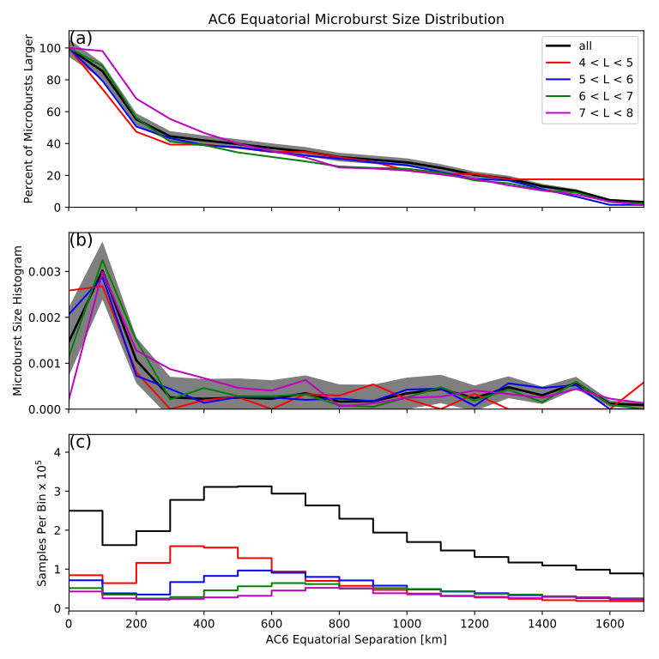
Microburst size distribution mapped to magnetic equator
Same procedure as the LEO distribution
Normalization is different
Most microbursts were generated in a < 200 km region
Implies that waves that scatter microbursts must have correlated properties on those spatial sizes

Slide 28
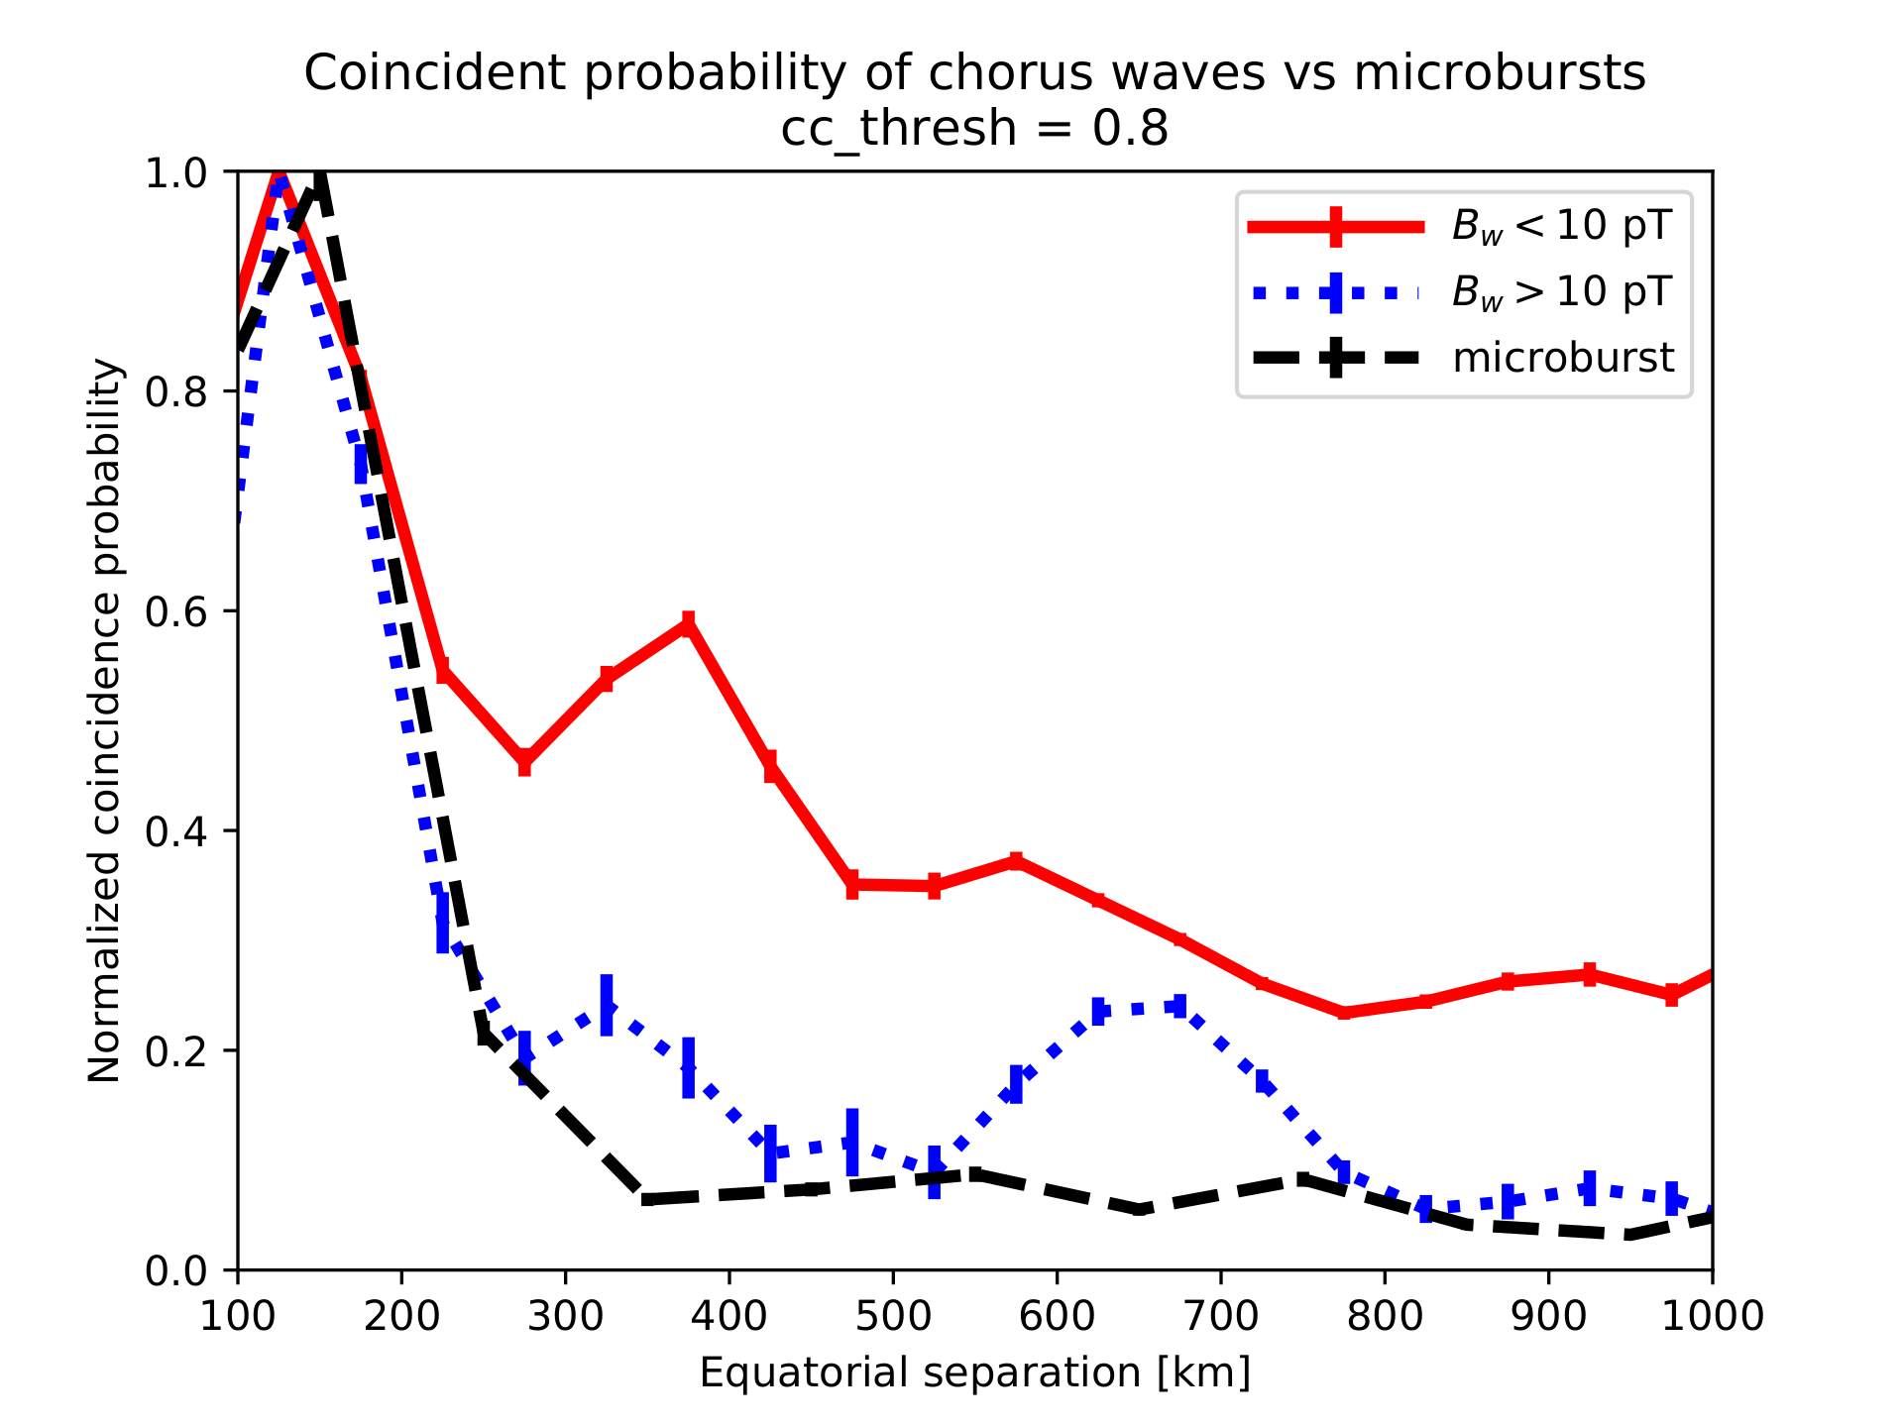
Compare The Microburst and Wave Distributions
Used a dataset from Agapitov et al., 2018
Chorus waves observed by the THEMIS mission were correlated
Waves were split up by low and high amplitude
The fraction of highly correlated chorus waves in each separation bin was calculated
Microburst distribution follows the high amplitude chorus waves more closely

Slide 29
Conclusions
Most microbursts observed for AC-6 separations less than a few tens of km
Majority of microbursts map to sizes less than 200 km at the magnetic equator
The equatorial microburst distribution better matches the high amplitude chorus wave distribution
Modeling the microburst size distribution is essential to understand the data
"We have to remember that what we observe is not nature herself, but nature exposed to our method of questioning." - Werner Heisenberg

Slide 30
Microburst scattering directly observed in the heart of the radiation belts
Shumko, M., Turner, D. L., O'Brien, T. P., Claudepierre, S. G., Sample, J., Hartley, D. P., ... & Mitchell, D. G. (2018). Evidence of microbursts observed near the equatorial plane in the outer van Allen radiation belt. Geophysical Research Letters, 45(16), 8044-8053.

Slide 31
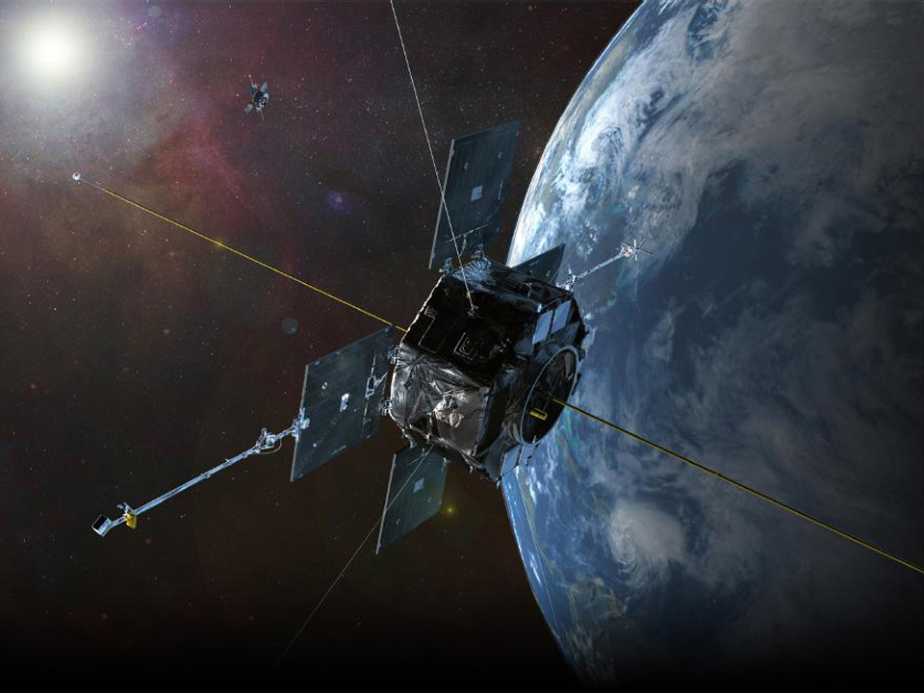
NASA's Van Allen Probes (RBSP)
Pair of identically instrumented satellites launched in August 2012
Orbit:
highly elliptical: 618 x 30,414 km
low inclination: 10.2°
Many instruments observing particles and waves
MagEIS
RBSPICE
EMFISIS
Spins with a 12 s period
Artist rendition from NASA

Slide 32
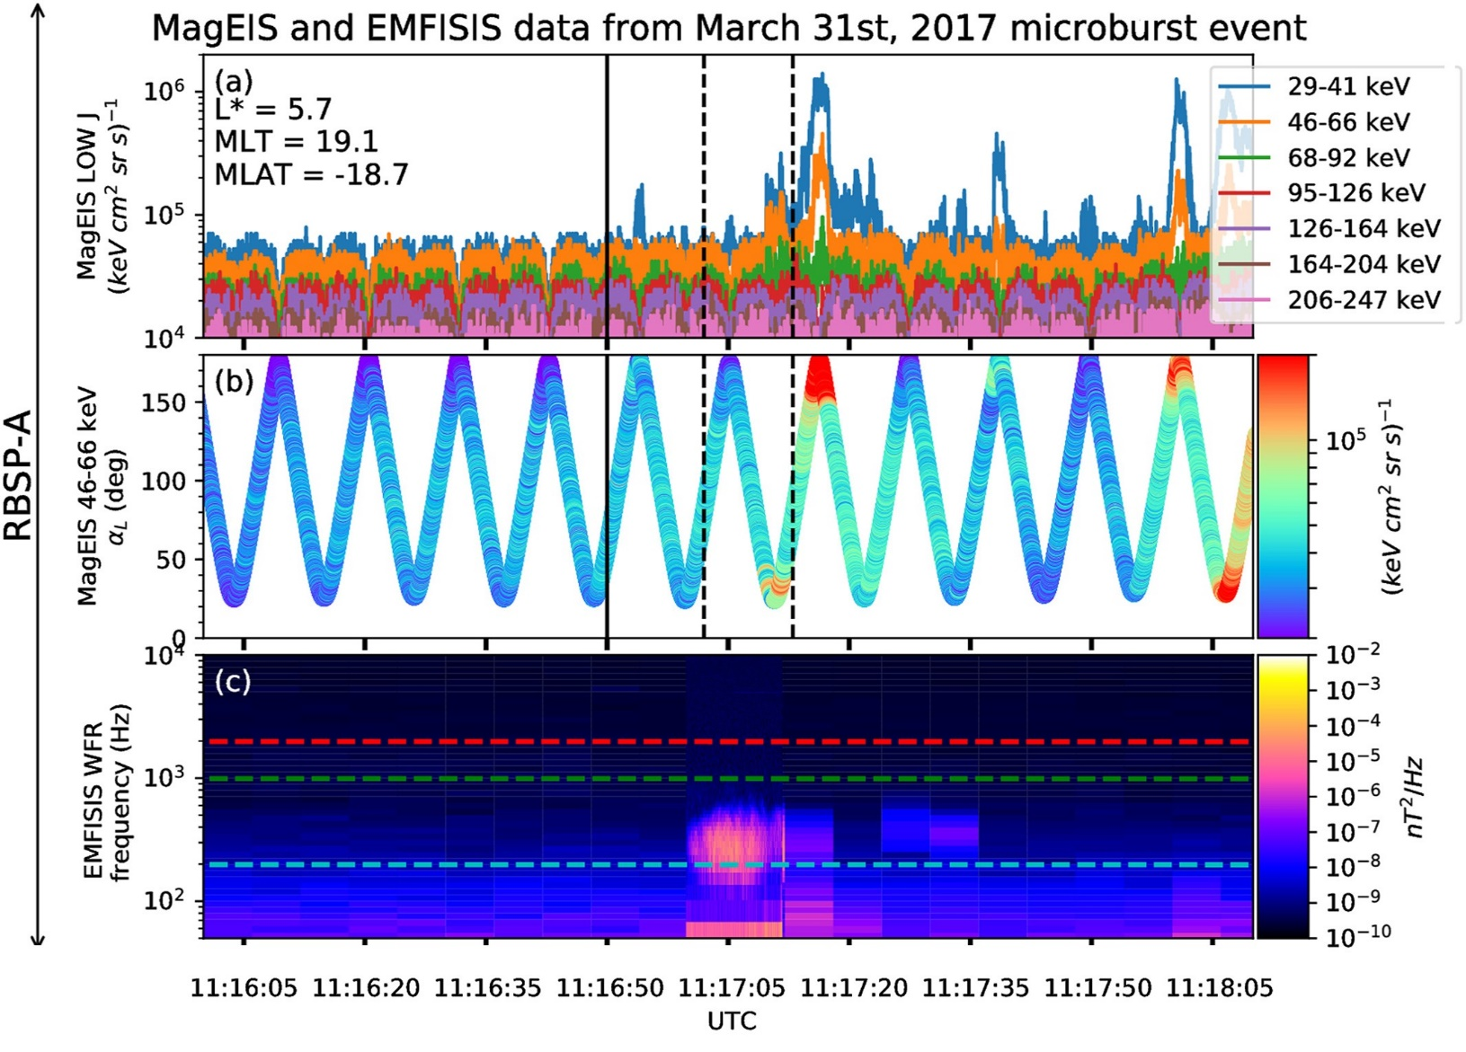
Microburst Observation
Microburst signatures observed 19° south of the magnetic equator
Microbursts observed by MagEIS and RBSPICE onboard RBSP-A
Strong wave power observed simultaneously in the lower band chorus frequency range

Slide 33
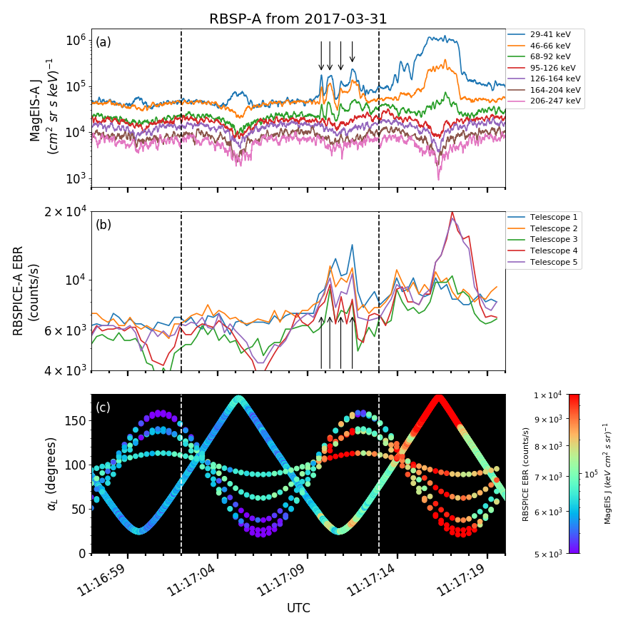
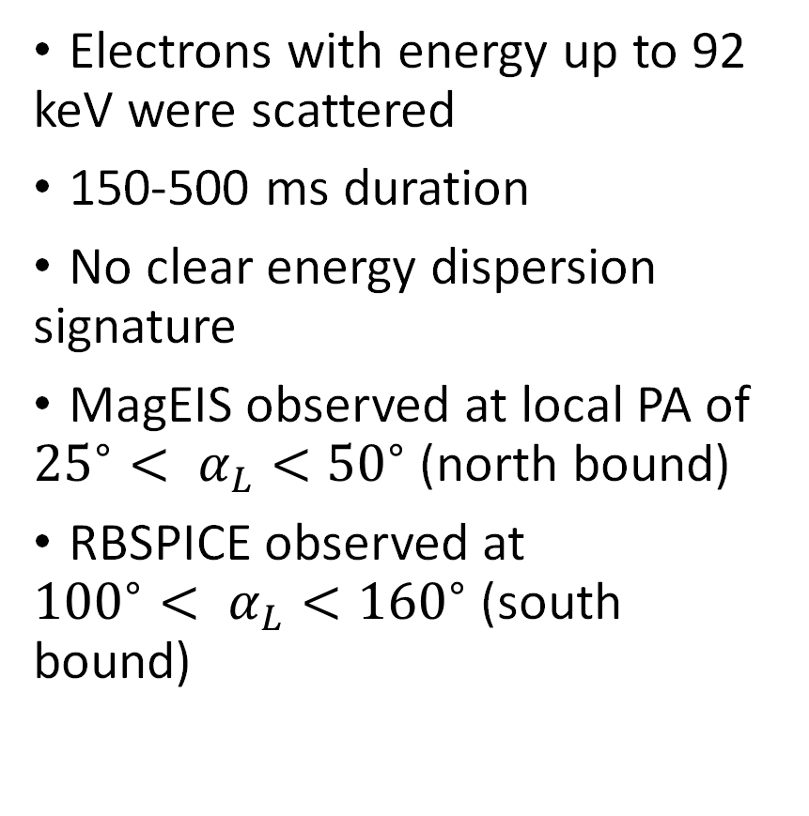
Microburst observation
Electrons with energy up to 92 keV were scattered
150-500 ms duration
No clear energy dispersion signature
MagEIS observed at local PA of ${{25}^{∘}< α}_{L}<{50}^{∘}$ (north bound)
RBSPICE observed at ${{100}^{∘}< α}_{L}<{160}^{∘}$ (south bound)

Slide 34
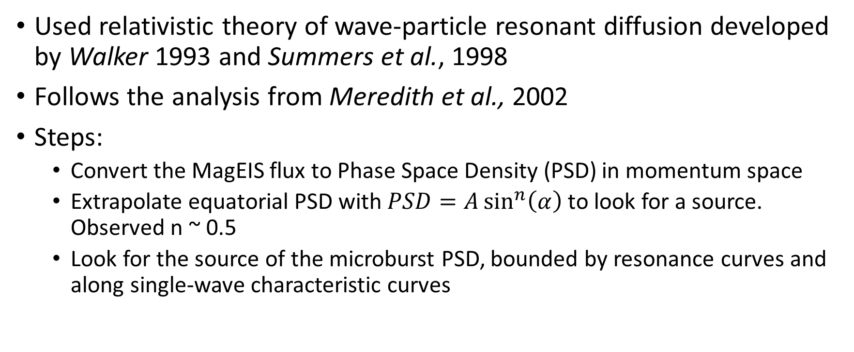
Model the scattering
Used relativistic theory of wave-particle resonant diffusion developed by Walker 1993 and Summers et al., 1998
Follows the analysis from Meredith et al., 2002
Steps:
Convert the MagEIS flux to Phase Space Density (PSD) in momentum space
Extrapolate equatorial PSD with $PSD=A\sin^{n}\left(α\right)$ to look for a source. Observed n ~ 0.5
Look for the source of the microburst PSD, bounded by resonance curves and along single-wave characteristic curves

Slide 35
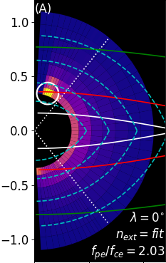
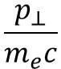
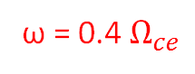
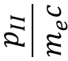
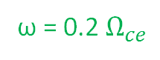
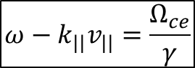

Resonance and Single Wave Characteristic Curves
Electron Cyclotron Resonance with Whistler Mode Waves (Parallel)
$$ω−k_{||}v_{||}=\frac{Ω_{ce}}{γ}$$
Colors: observed phase space density
White circle: microburst PSD
Boundary: observed/extrapolated PSD
$$\frac{p_{II}}{m_{e}c}$$
ω = 0.2 $Ω_{ce}$
Resonance curves Resonance condition describes a family of curves in momentum space for which e⁻ are in cyclotron resonance with wave of frequency ω
ω = 0.4 $Ω_{ce}$
ω = 0.6 $Ω_{ce}$
Single Wave Characteristic curves Trajectories along which e⁻ will move due to interaction w/whistler mode waves over some frequency range
Cyclotron Resonance e⁻ diffuse from high to low PSD along the single wave characteristic curves
If in the direction of increasing energy: e⁻ gain energy/wave loses energy
If in the direction of decreasing energy: e⁻ lose energy/wave gains energy
$$\frac{p_{⊥}}{m_{e}c}$$
Notes:
Mention how we use the extrapolation here to see under which extrapolation regimes is there enough source PSD. We would expect the source to be equatorward.
19 degrees off the equator so a huge chunk of electrons not observed

Slide 36
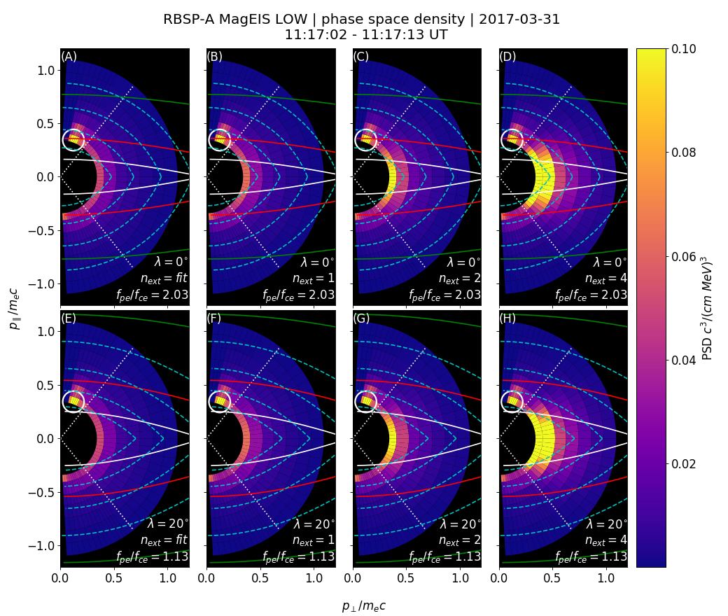
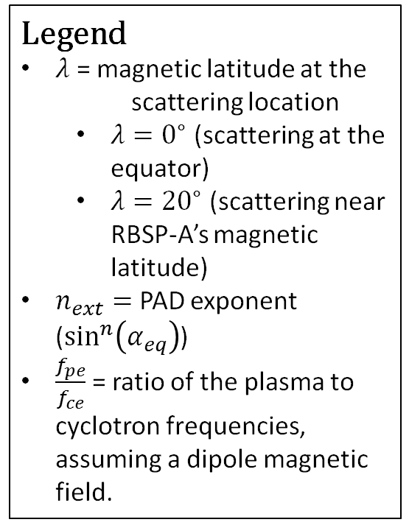
Explore Various Model Parameters
Legend
$λ$ = magnetic latitude at the scattering location
$λ=0^{∘}$ (scattering at the equator)
$λ={20}^{∘}$ (scattering near RBSP-A’s magnetic latitude)
$n_{ext}=$ PAD exponent ($\sin^{n}\left(α_{eq}\right)$)
$\frac{f_{pe}}{f_{ce}}$ = ratio of the plasma to cyclotron frequencies, assuming a dipole magnetic field.
Notes:
Note: resonance energy increases with scattering latitude. With increased scattering latitude, the change in energy is larger

Slide 37
Conclusions
Observations of microbursts at the magnetic equator allows us to study the wave-particle interactions in-situ. No need for conjunction studies.
Microburst electrons do not appear to have been transported along single wave characteristic curves
Need 5-10x more PSD near the magnetic equator than estimated from the data
These microbursts may have been generated during wave generation e.g. Hikishima et al., 2010

Slide 38
Path Forward
Use the AC-6 data to study stationary structures e.g. "curtains" [Blake et al., 2016] and test the hypothesis that curtains are microbursts in the drift loss cone
Detailed study comparing the microburst and wave sizes
Apply to other waves and particle precipitation [e.g. Agapitov et al., 2018 and Blum et al., 2017]
A statistical study of microbursts and waves observed in-situ with the Van Allen Probes

Slide 39
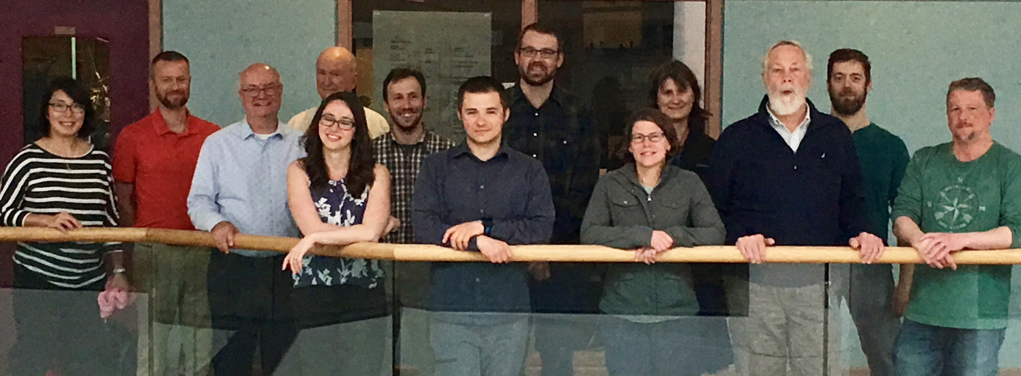










Acknowledgements
"If I have seen further it is by standing on the shoulders of Giants." - Isaac Newton

Slide 40
Backup Slides

Slide 41
Microburst Size Estimated From FIREBIRD-II

Slide 42


"FUX fit" curves calculated using the time difference between peak maxima
"FU3 minima" curve calculated using the time differences between peak minimums
Drift rates

Slide 43
Markov Chain Monte Carlo

Slide 44
Bayes Theorem
P(A|B) = P(B|A)P(A)
P(B)
Derivation:
If events A and B are independent, then the probability of events A and B happening, P(A, B) = P(A)P(B).
But if events A and B are dependent, then P(A, B) = P(B)P(A|B). In other words, it is the probability of B happening multiplied by probability of A happening IF B has happened.
Since A and B are interchangeable, P(B, A) = P(A, B) -> P(B)P(A|B) = P(A)P(B|A). Rearrange and you get P(A|B) = P(B|A)P(A)/P(B)

Slide 45

Metropolis–Hastings MCMC Sampler
Choose an arbitrary starting point, x₀ in parameter space
For each iteration i in N trials,
Propose a new x_{i} using a random distribution e.g. normal centered on x_{i-1}
Calculate the posterior probability for x_{i} and x_{i-1} and the ratio
α = P(x_{i})/P(x_{i-1})
If α > 1, accept the proposal
Otherwise generate a random number u between 0 and 1. If u < α accept the proposal, otherwise reject it and pick a new proposal

Slide 46
Analytic Derivation of The Microburst Fraction

Slide 47


Slide 48



Slide 49
Continuous Microburst Size PDF Models

Slide 50

Maxwell Microburst PDF

Slide 51

Weibull Microburst PDF

Slide 52

Log-normal Microburst PDF

Slide 53
Single Wave Characteristics Derivation

Slide 54
Charged Particle Motion in Magnetic Fields

